Slide 1

MAMBA MENTALITY
— Use NBA Player Stats, Teams and Year Effects to Predict Teams’ Wining Rate

Slide 2

A
G
E
N
D
A
CASE OVERVIEW
DATA & PREPARATION
EXPLORATORY ANALYSIS
KEY
INSIGHTS
MODELING
APPENDIX

Slide 3
01 CASE OVERVIEW
Kobe Bryant inspires everyone with mamba mentality: the thirst for victory. Every day, every player puts their best efforts to win the game -- that’s mamba mentality. The whole team coalesced to put their best efforts to win the game -- that’s mamba mentality. In memory of the great Kobe Bryant, we want to study something about team victory with that dimension of everyone’s contribution to the sweat and tears once shed on the NBA field.

Slide 4
CONTEXT UNDERSTANDING
Why we want to study this topic:
Help understand what makes a strong team that stands out winning more games
Potential insights for team management on better player recruitment strategies
Possible usage for NBA sports gambling
Type of Our Predictive Problem: Regression Problem – target variable “winning PCT” (continuous valued, range from 0 to 1)
Some important concepts in the data & modeling process:
- PER: Player Efficiency Rating; sums up all a player’s positive accomplishments, subtracts the negative accomplishments, and returns a per-minute rating of a player’s performance
-DWS: Defensive Win Shares, a player statistic that divvy up credit for a team’s success onto individual players on the team; calculated using player, team and league-wide statistics and the sum of player win shares on a given team roughly equivalent to the team’s win total for the season
-”TS%”: True Shooting Percentage, formula: ”Points/(2*True Shooting Attempts)”; takes into account field goals, 3-point field goals, and free throws
-“FT%”: Free Throw Percentage, formula: “Free Throws/Free Throw Attempts”
-”TOV%”: Turnover Percentage, formula: “100*Turnovers/(Field Goal Attempts + 0.44*Free Throws Attempts + Turnovers)”
C
omplete players stats data
teams performance data
Notes:
source for “DWS”: https://www.basketball-reference.com/about/ws.html
more detailed formulas: see book “Basketball on Paper”: http://www.basketballonpaper.com

Slide 5

02 DATA& PERPARATION

Slide 6
DATA SOURCE
extracted from original source on Kaggle: “NBA stats until 2018-2019”
all NBA players’ stats information for the past recent 19 years (2000-2011 season to 2018-2019 season)
11080 records
manually collected and organized from two sources: teamrankings.com & Wikipedia (for some earlier years)
teams’ winning percentage (“winning PCT”) for each complete season, conference affiliation & more
560+ records
binding key: year & team name(abbr)
complete players stats data
teams performance data
Some interesting & important notices during data preparation & merging:
30 teams (east & west 15:15) after 2003-2004 season; 29 teams (east 15 & west 14) before 2003-2004 season
teams’ histories: some teams went through changes in name, location and people during the years, and may have had 2 or 3 different names across different historical periods (e.g. now “Charlotte Hornets”; now “Brooklyn Nets”)
some players may have played for multiple teams (or otther special cases) in a single season → these sitatutions not considered
Notes:
Source:
Kaggle: https://www.kaggle.com/lancharro5/seasons-stats-50-19
teamrankings.com “NBA Team Win % - All Games”: https://www.teamrankings.com/nba/stat/win-pct-all-games?date=2019-06-14
why only most recent 20 years: expect years further away from now may involve more changes on the playing rules, norms and dynamics in the NBA world itself
”teams performance data”: didn’t find cleaned, organized data set, so some manual work; data for some earlier years are a little hard to find
”some interesting & important notices during preparation…”:
-30 vs. 29 teams: the original East team “Charlotte Hornets” owned by George Shinn relocated to New Orleans and became “New Orleans Hornets” during 2002-2004 seasons (while the original “Charlotte Hornets” did not exist for two seasons), yet later this team was assigned to the west conference when it became “New Orleans-Oklahoma City Hornets”; at the same time, an expansion team “Charlotte Bobcats” was established in place of the original “Charlotte Hornets” after 2004
-different team names: different team abbreviations → cause trouble in binding and great carefulness needed
-multiple teams played: “TOT”

Slide 7

03 EXPLORATORY ANALYSIS

Slide 8
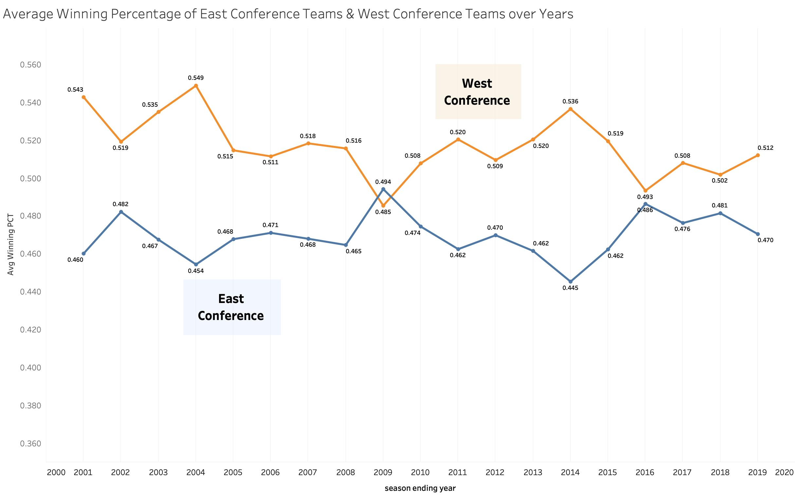
Average Winning PCT Comparison between teams in East & West Conference
Teams in West Conference are stronger in winning PCT performance than teams in East Conference in most cases
An interesting symmetric pattern in trend of changes over years
shifts of rise and drop in winning PCT between East and West
gaps between East and West enlarges and diminishes
Notice 2008-2009 season only: average winning PCT of East teams higher than that of West teams
Plausibly, East’s best teams are as dominant as the West’s best teams (e.g. Boston Celtics, Miami Heat, Milwaukee Bucks), and East’s middle-class teams were just as respectable as their counterparts, in that specific year
East has so many top players as the West (e.g. LeBron James in Cleveland Cavaliers)
Notes:
“west stronger than east”: west’s winning PCT above 0.5 in most cases, while east’s winning PCT below 0.5 almost always
***interesting source: https://www.theringer.com/nba/2019/12/16/21023780/east-west-nba-conference-imbalance
"Any basketball fan who has even casually checked the standings since Michael Jordan left the Bulls, knows the NBA’s strength tilts westward. Season after season, the Western Conference outperforms the East—in individual talent, in depth of quality teams, in the 30 interconference games that each team plays every season."
"2009 special": East seemed to dominate interconference play against West for the same time, signaling a possible switch

Slide 9
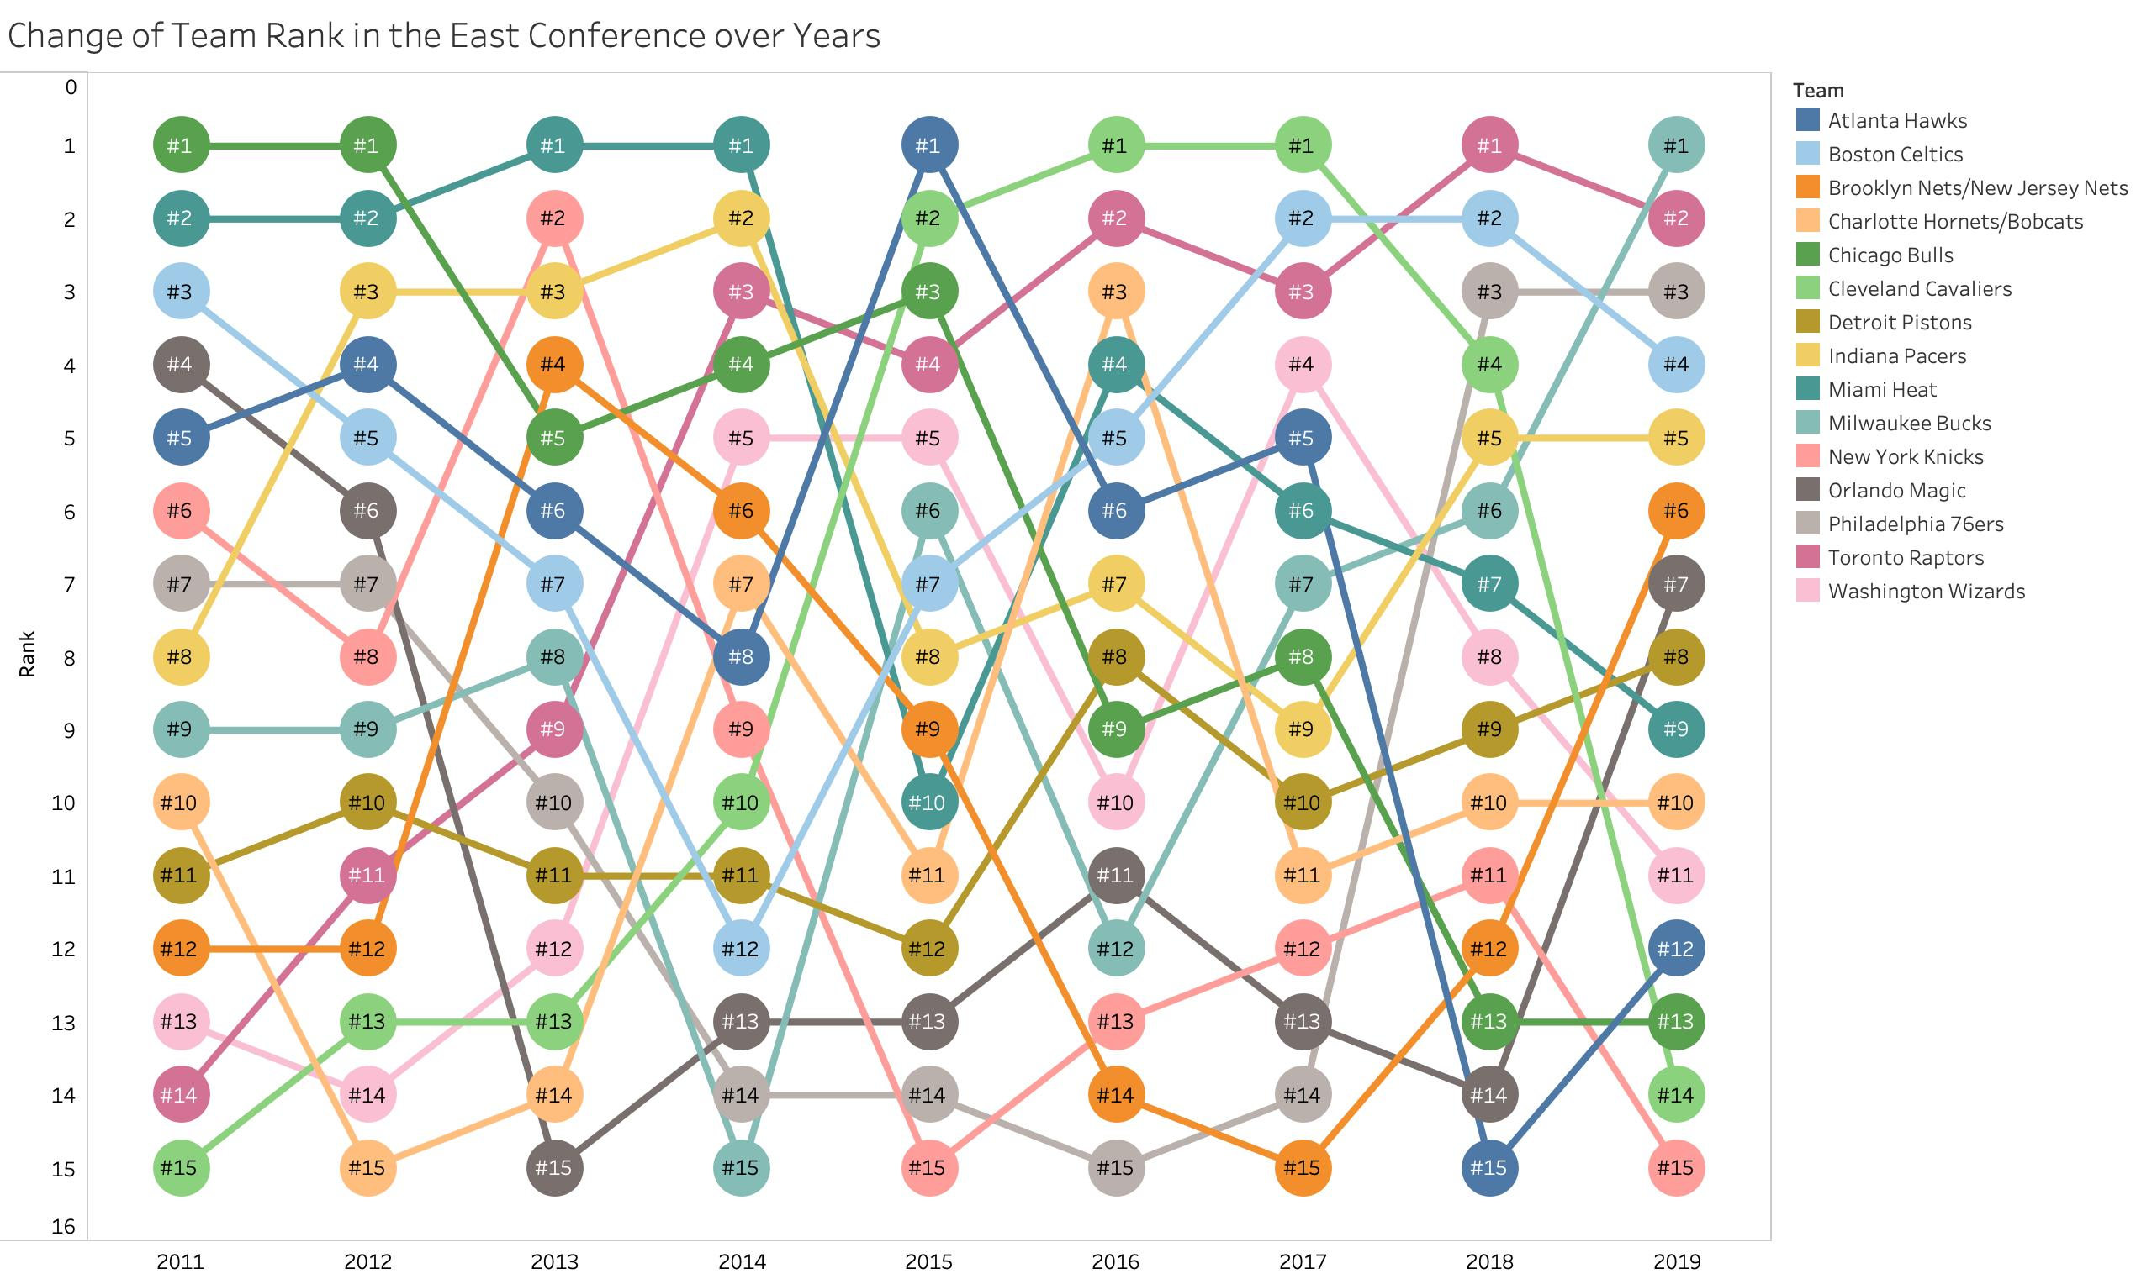
Changing Team Ranks in the East Conference 2011-2019 (Demo)
Rank based on winning PCT
interesting types of teams in light of trends about team ranks
teams with significant increase over years: Milwaukee Bucks and Toronto Raptors
teams with significant decrease over years: Chicago Bulls, Miami Heat, New York Knicks, and locally, Atlanta Hawks
teams keeping relatively steady performance: Detroit Pistons etc.
teams with “roller coaster” like performance: Cleveland Cavaliers, Brooklyn Nets

Slide 10
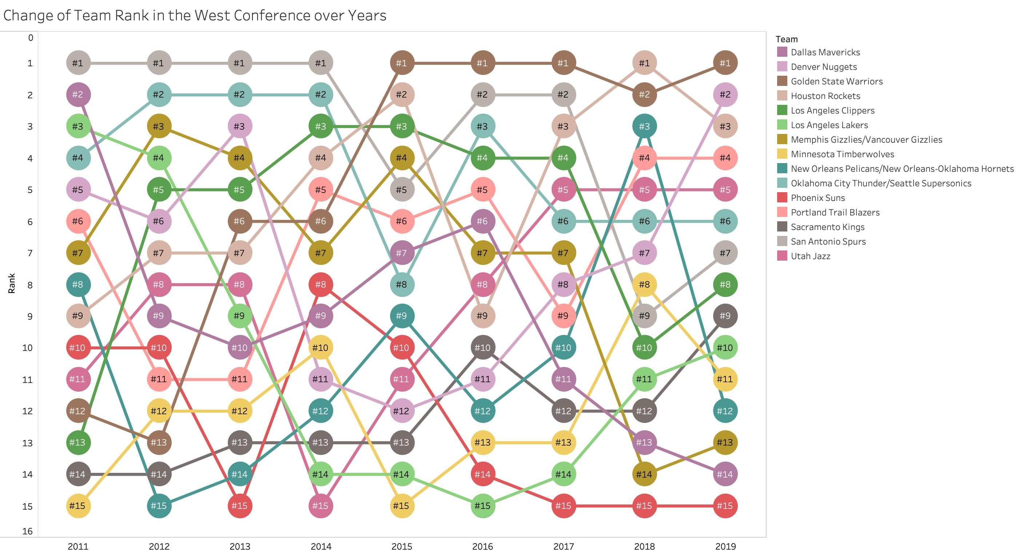
Changing Team Ranks in the West Conference 2011-2019 (Demo)
interesting types of teams in light of trends about team ranks
teams with significant increase over years: Houston Rockets, Utah Jazz, Golden State Warriors, etc.
teams with significant decrease over years: Dallas Mavericks Memphis Grizzlies, etc.

Slide 11
04 MODELING
Panel Regression Model on the Whole Data
Panel Regression Model on East Conference Data
Panel Regression Model on East Conference Data

Slide 12

MODELING APPROACH
Player’s position, age, and 44 player basic stats including score, rebounds, assists ...etc
Players’ Stats
Use Regression Model to Predict Teams’ Winning Rate And See What Features Tend To Influence Winning Rate Most
Year
33 Teams (30 +3) Conference (East & West)
Fixed Factor

Slide 13
Data Filtering
As we know, each team in a game can have 12 player in their rotation list, but most of the time only 7 to 9 players have opportunities to be on court; so we remove those player who has very low MP(Minutes Played) since they usually do not make a lot of impacts on teams’ winning rate.
We also remove columns like players name and league rank since they are not very useful for our model.

Slide 14
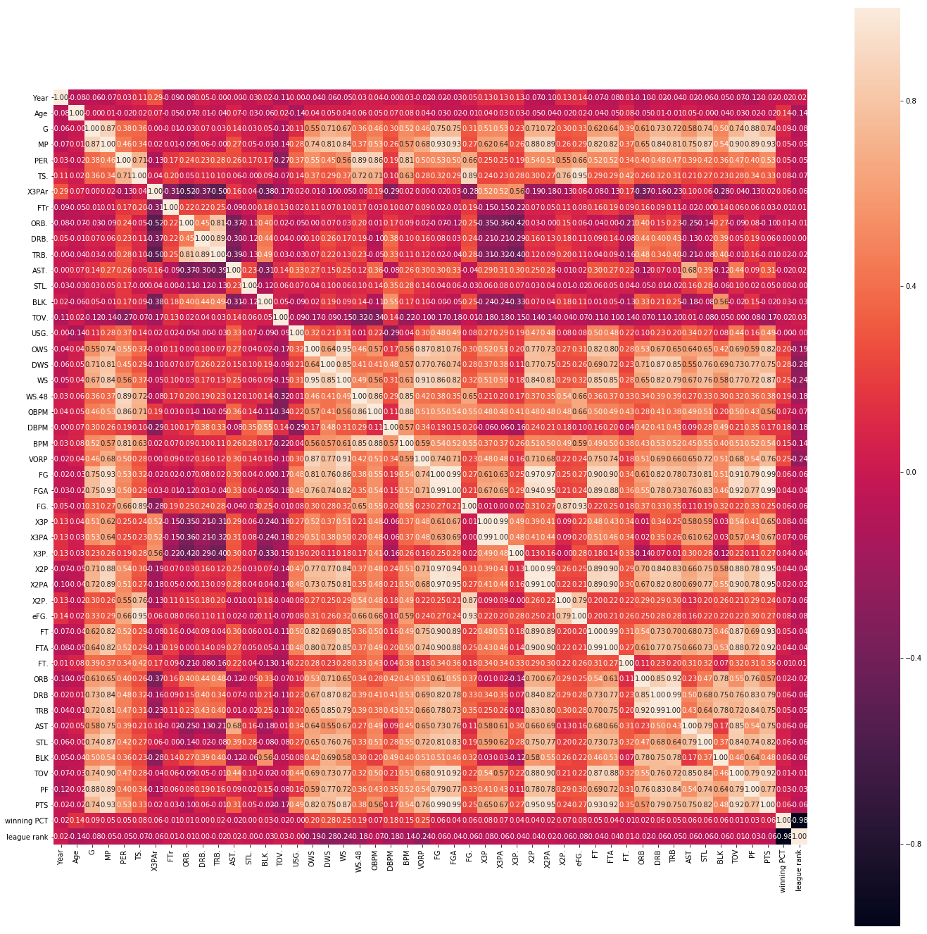
Correlation- Heat Map
0.8
We can see that there are some features highly correlated, so we remove those features for our future model building.

Slide 15
Fixed Effect Model
Definition
2001 ATL Player Stats
2001 BOS …
2001 CHI
2002 ATL
2002 BOS
2002 CHI
2003 ATL
2003 BOS
2003 CHI
In statistics, a fixed effects model is a statistical model in which the model parameters are fixed or non-random quantities. This contrasts with random effects models and mixed models in which all or some of the model parameters are considered as random variables.
* Detect the fixed effect from years and team, investigate the players’ contribution to wining rate

Slide 16
Panel Regression Model on East Conference Data
Features | Parameters | P-Value
Age | 0.0024 | 0.000 ***
TS% | 0.0799 | 0.0108 *
FT% | 0.0102 | 0.000 ***
TOV% | -0.0004 | 0.014 *
BLK% | -0.0002 | 0.014 *
Position PG | 0.0152 | 0.000 ***
Model R-squared: 0.53
TS% - True Shooting Percentage
FT% - Free Throw Percentage
TOV% - Turnover Percentage
BLK% - Block Percentage
Notes:
“BLK%”: Block Percentage

Slide 17
Panel Regression Model on West Conference Data
Features | Parameters | P-Value
Age | 0.0036 | 0.000 ***
TS% | 0.0921 | 0.1340
FT% | 0.0517 | 0.000 ***
TOV% | -0.0003 | 0.001 ***
BLK% | -0.0003 | 0.0047 **
Position PG | 0.0154 | 0.001 **
Position C | -0.0278 | 0.000 ***
Position SF | -0.0179 | 0.000 ***
Model R-squared: 0.52
Notes:
”Position PG”, “Position C”, “Position SF”: whether a player is in this position on the team; all are binary variables

Slide 18
Regression Model on the Whole Data
Features | Parameters | P-Value
Age | 0.0027 | 0.0001 ***
PER | 0.0158 | 0.0001 ***
Game Played | 0.0025 | 0.0001 ***
DWS | 0.1072 | 0.0001 ***
FG. | 0.4102 | 0.0001 ***
ORB | 0.006 | 0.0001 ***
Model R-squared: 0.41
PER - Player Efficiency Rating
DWS – Defensive Win Shares
Notes:
“FG.”: Field Goals, include both 2-point and 3-point field goals
“ORB”: Offensive Rebounds

Slide 19
05 INSIGHTS
There are some features shared in the models we built, for example players’ age, TS% and FT%, it could be a guide for team’s to help them what kind of players they want to recruit.
Most players’ stats alone can’t have the precise prediction on teams’ winning rate, while the combination of these stats can lead to better prediction and understanding of which stat contribute more.

Slide 20
05 INSIGHTS
We can see the models that only predict East/ West conference have better performance than predicts on whole data; meaning there exists differences between two conferences, and strategies for teams in different conference should be different as well.
Besides our x variables, panel model also take time and each teams into consideration. From our model summary (In appendix), we can see that the "R-squared between" is relatively low, means there are other factors might influence teams' win rate, for example coach, team culture and team tactics.

Slide 21

From the player position outcomes, we can have two assumption on the outcomes:
1. Different player position can have different impact on the wining rate outcomes, especially Point Guards have more significant positive influence on the victory while other position can be less decisive
2. There are more Centers and Small Forward in weaker teams, which results in the negative coefficients of these two positions on the wining rate.

Slide 22
THANK YOU!
Any Questions?

Slide 23
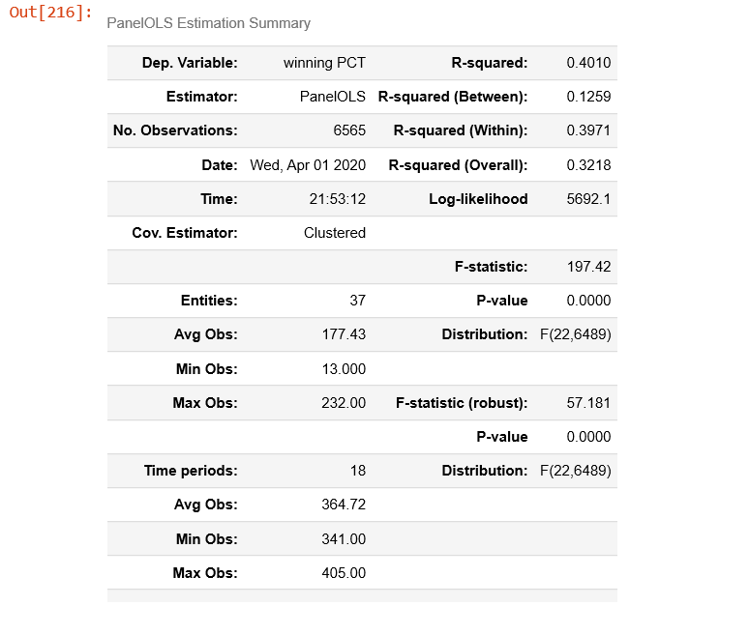
06 Appendix
Panel model summary for whole data

Slide 24
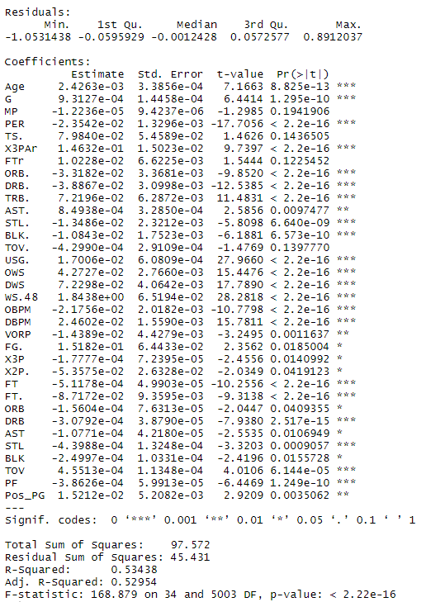
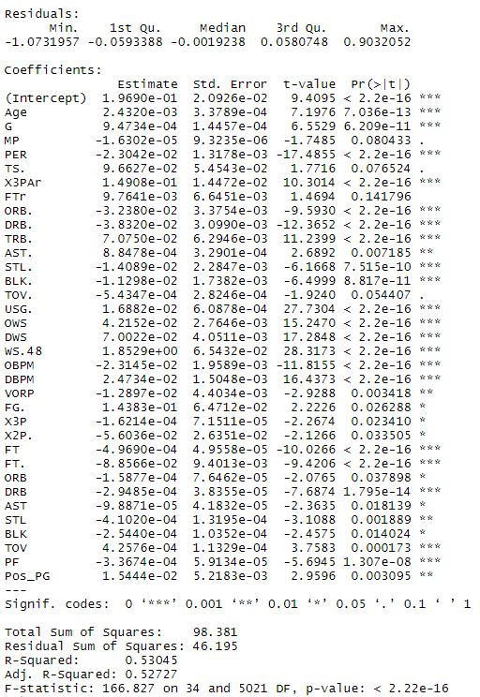
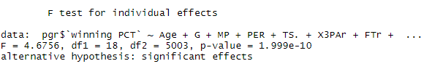
Panel Regression Model on East Conference Data
Fixed Effect
Mixed Effect
F-test

Slide 25
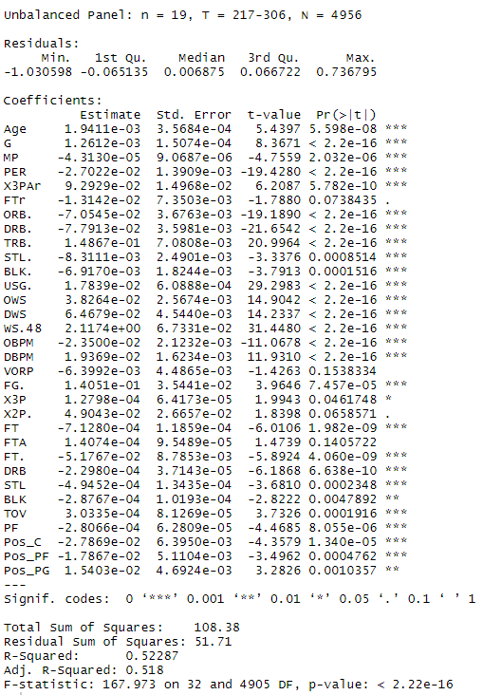
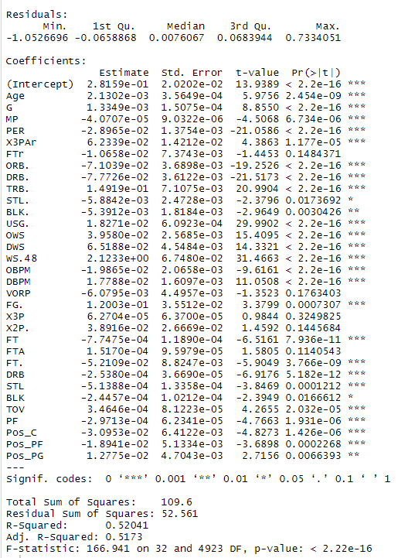
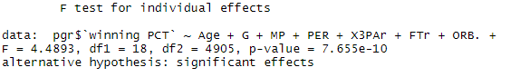
Panel Regression Model on West Conference Data
Fixed Effect
Mixed Effect
F-test

